Slide 1


caArray User Community Meeting
caArray User Community Meeting
2.2.0 Feature Overview and Review of MAGE-TAB Update and Export Specification
Release Schedule and Demo
Call in: 877-416-5524
Participant Passcode: 2627056
Centra: http://ncicb.centra.com
Meeting ID: ICR_meeting
November 5, 2008
Call in: 877-416-5524
Participant Passcode: 2627056
Centra: http://ncicb.centra.com
Meeting ID: ICR_meeting
August 5, 2009

Slide 2
Agenda
Release Schedule
  2.3.0
Annotare
  Demo of this new MAGE-TAB annotation tool
Support / Knowledge Centre

Slide 3
Release Schedule
caArray 2.3.0
Release targeted for ?
Staging tier has RC2
  Available outside the firewall for integration development
Highlighted features:
  New API: richer, faster, enables backwards compatibility.
  Audit trail of permissions changes.
  Separation of experiment locking from permissions control.
  Ability to download array designs.

Slide 4
Annotare
Annotare: a new MAGE-TAB annotation tool
  Being developed by organizations active in the MGED society.
  Helps create IDF and SDRF files for bulk import of annotations.
  Helps describe your investigation, samples and data.
Release schedule
  First release anticipated next month (September, 2009)
  Will support MAGE-TAB v1.0.
  MAGE-TAB v1.1 support will be added later.

Slide 5
Annotare
Guides selection of annotations
  Suggests experimental factors basd on your chosen experimental design.
  Enables selection of controlled vocabulary terms from ontologies like EFO (Experimental Factor Ontology).
  Provides pre-built templates for common study types.
Validates
  Validates IDF and SDRF against MAGE-TAB standard.
  Future: pluggable validator modules for different applications.

Slide 6
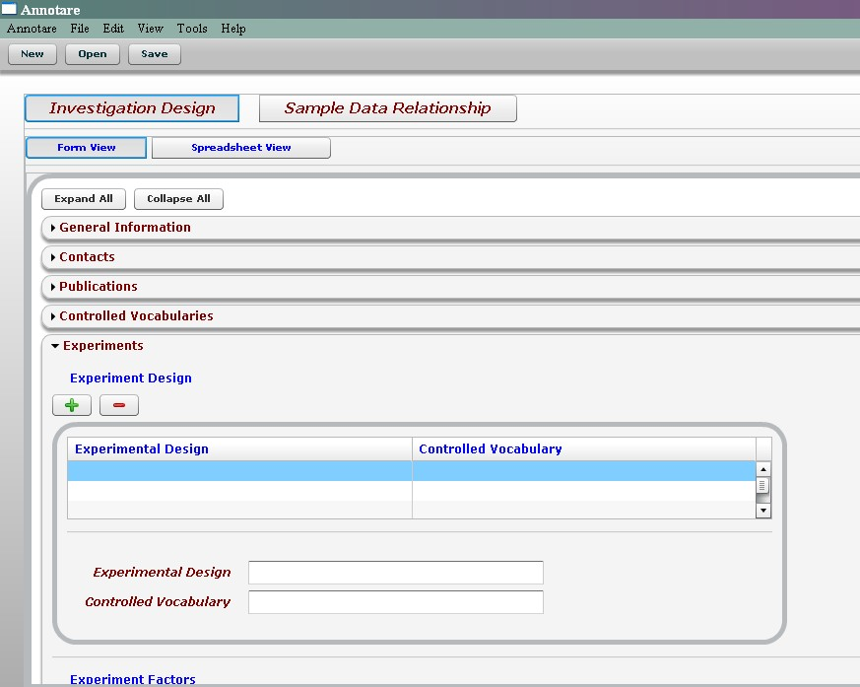
Annotare Demo

Slide 7
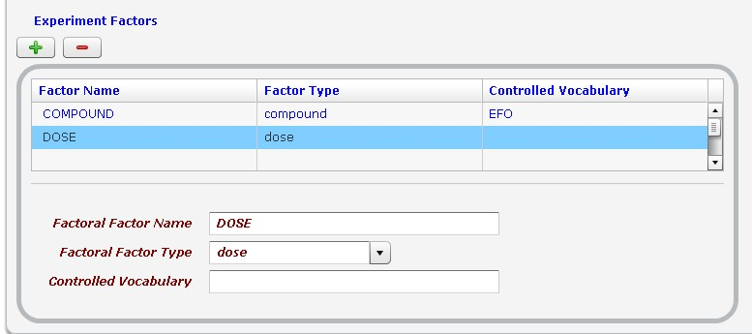
Annotare Demo

Slide 8
What’s New on caArray Support
New demos?
User Scenario Solicitation
  Tell us your use cases, we will build demos to show you how to achieve your use cases using MATKC tools if feasible

Slide 9
Avenues for Feedback
Molecular Analysis Tools Knowledge Center Forum
Gforge Community Change Request tracker:
  http://gforge.nci.nih.gov/tracker/?atid=1339&group_id=305&func=browse
This meeting
Next Meeting:
Wednesday, September 2, 2:00 PM ET

